Slide 1


What The Hack
Internal
Niraimathi, Harsha, Medha, Ragupathi, Ramya

Slide 2

Internal

Slide 3
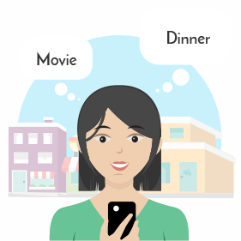
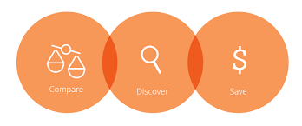



Problem Statement
Worried about where to go??
Explore the amazing offers at restaurants, spas, gyms, movies, hotels and more around you.
Compare Online and Offline offers
Locate the store near you by using our Indoor and Outdoor navigation facility
Liked the place?? Rate them ☺
Enjoy your day

Slide 4




Problem Statement
Opening a new store?
Worried about Marketing???
Don’t worry! watZAround is here ☺
Register your store with us
Add the amazing offers that your store has to offer
Sit back and Relax ☺ We will market your store to the right audience around you

Slide 5
DEMO

Slide 6
Q&A

Slide 7
Thank you

Slide 10
The Grid
Headline area
White space
Drawing area

